Slide 1
Lecture 11
8086 Microprocessor
Interrupt System

Slide 2
8086 Interrupt System
Interrupt system allows smooth operation of computer system
It allows the processor to handle some unusual circumstances
It helps various external hardware to communicate with the processor
Three types of interrupts
  Predefined interrupts
  Software interrupts (User-defined)
  Hardware interrupts (User-defined)

Slide 3
Interrupts
All the 8086 interrupts has its service routine
The location of the service routines are found from a table stored in locations (00000H to 003FFH)
This table contains CS and IP values needed to access the service routines
Four bytes (2 bytes for CS and 2 bytes for IP) are assigned to each interrupt
The table can contain 256 interrupt vector addresses
8086 assigns a number/type code (0-255) for each interrupt
By using the type code/number 8086 obtains CS and IP values from the table which are then used to compute 20 bit physical address
This PA is the starting location of the service routine for a particular interrupt.

Slide 4
How to find IP and CS values from the table
If interrupt number is nn
Table address for IP
=4*nn
Table address for CS
=4*nn+2
Example:
INT 2
The service routine of type code 2 is accessed first by finding the value IP and CS from the table.
The IP value is in table address: 4*2=00008H
The CS value is in table address: 4*2+2=0000AH
Then the processor calculates the physical address of service routine:
CS*10H+IP
Interrupt type code
20 bit address
IP
00000H
0
CS
00002H
IP
00004H
1
CS
00006H
00008H
2
0000AH
.
.
.
.
IP
003FEH
255
00400H
CS

Slide 5
Response to an interrupt
When an interrupt occurs
  processor saves the contents of flag register, CS and IP onto stack, clears TF and IF flags
  Then loads new IP and CS values found from the table using the type code.
  Then execute the service routine,
  The last instruction of service routine is IRET (interrupt return) which pops the IP, CS and flags, thus return to the main program

Slide 6
256 interrupts
Predefined interrupts: Types 0 to 4
Reserved for software: 5 to 31
Hardware interrupts: 32 to 255

Slide 7
Predefined interrupts (type 0-4): Non-maskable
Type 0: Division by zero. Whenever a division by zero is attempted, processor is interrupted and type code 0 is executed. It is nonmaskable
Type 1: Single step mode. When TF=1, processor goes into single step mode and type code 1 is executed after execution of each instruction.
Type 2: Interrupt initiated by NMI pin. Edge triggered and must be active for two clock cycles at the NMI pin. This interrupt occurs during power failure and processor executes service routine of 2.
Type 3: Breakpoint interrupt. The user can insert instruction INT3 into a program. Breakpoints are useful for program debugging.
Type 4: Interrupt on overflow. This interrupt occurs when OF=1 and INTO instruction is executed. If there is an overflow , an error service routine at the type 4 interrupt address vector is executed.

Slide 8
Software interrupts (type 5-31): Non-maskable
The user can execute any interrupt service routine by executing a two byte instruction INT nn. Type codes 5-31 can be used.
This way calling interrupt service routine occurs in programs; thereby is called software interrupt.
Example: INT 21H, INT 16H

Slide 9
Hardware interrupts (type 32-255): Maskable interrupts
These interrupts are maskable and enabled or disabled by IF flag.
If IF=1 and INTR pin gets active HIGH signal without occurrence of any other interrupt processor after completing current instruction outputs INTA LOW and causes the hardware to provide its interrupt type code number
Then the processor finds the type code’s IP and CS values from the table and executes the service routine
ALE
Address Bus
AD0-AD19
20
INTA
8086
Low Data Bus D0-D7
8
74LS 244
nn of INT nn 32 to 255
Enable
8

Slide 10
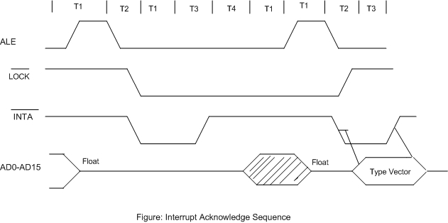
Interrupt acknowledge sequence
INTA sequence includes two INTA cycles
ALE signal is given and will load the address latches with some indeterminate information
The first INTA bus cycle indicates that interrupt acknowledge is in progress and allows the hardware to be ready to place the interrupt type code on the next INTA bus cycle.

Slide 11
Interrupt Priorities
Priority 1: Single step mode
Priority 2: NMI pin interrupt
Priority 3: Software interrupt
Lowest priority: Hardware interrupt (works only when no other interrupt is working)
Exception: If single step, NMI and software interrupt is pending, software interrupt will be executed first then NMI and single stepping will not be serviced.

